Slide 1
Week 5 Lecture 1
Representation

Slide 2
Representation
Representation is concerned with how a computer stores objects
Representation of digital media
– Documents (text)
– Graphics (illustrations, cartoons, etc)
– Images (photographs)
– Audio (voice, music)
– Video
– Internet multimedia

Slide 3
Representation
The real world is continuous
  Infinite number of shades of a particular colour
  Circles made up of curves, not small dots
  Time, space
Computers deal with numerical world
  Discrete

Slide 4
Representation
Definition: countable sets
  Finite number of colours on monitor
  Resolution
All information on computer is in binary
Number Binary
23 10111
45.625 101101.101
0.1875 0.0011
ASCII: American Standard Code for Information Interchange (for character coding)

Slide 5
ASCII
A 1000001
B 1000010
C 1000011
.. .............
a 1100001
b 1100010
c 1100011
.. .............
1 0110001
2 0110010
3 0110011
Given the binary code 1000001, what does it represent?
  A (character)
  65 (number)
Depends on the context..
...needs to be interpreted

Slide 6
Converting between number systems
10111₂
= 1×2⁴+0×2³+1×2²+1×2¹+1×2⁰
= 16 + 0 + 4 + 2 + 1
= 23₁₀
Common representations:
• Binary, Decimal...
• Octal, hexadecimal
Octal:
375₈
= 3 × 8² + 7 × 8¹ + 5 × 8⁰
= 3 × 64 + 7 × 8 + 5 × 1
= 192 + 56 + 1 = 249
Going from decimal to octal:
  153₁₀
  What are the positions?
(Starting with LEAST SIGNIFICANTposition)

Slide 7
Number Systems
1, 8, 64, 512...
512 is too high, use 64
How many units? 153/64 = 2
Remainder = 153 − 128 = 25
Repeat the process
How many units of 8? 25/8 = 3
How many units of 1? 1.
  Answer = 231₈
  (153₁₀) and (231₈)
How to convert between binary, octal and hexadecimal

Slide 8
File formats
Documents, images etc…
Mark up languages
HTML, Latex, XML etc.
Languages that specify how something should look
Definition: File Format
  How data is arranged in the file
  The structure that determines how the file is organized and displayed
  Format usually indicated by three or four letter extension
  This identifies what the file is compatible with, e.g. program and/or computer
Aside: Why are some three letter extensions used when four letter ones make more sense?

Slide 9
File Formats
MS-DOS
All file names were of the form:
  Name (Up to eight letters)
  Type (Usually three letters)
File types
  Plain text
  Contains ONLY text
  e.g. created by Notepad, Emacs, gedit etc.
  Viewable in any text editor or by more, less (unix/linux commands) etc…

Slide 10
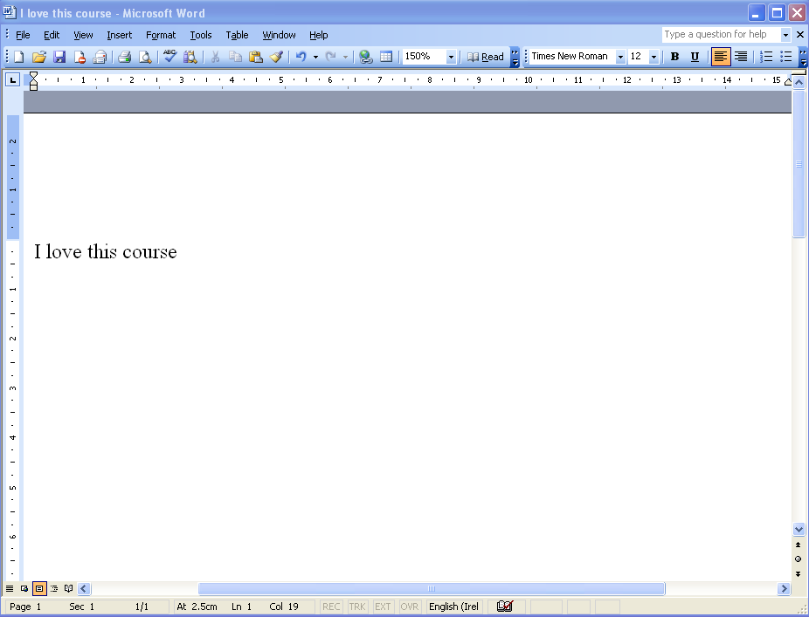
File Formats
Binary
  Contains binary encoding of SOMETHING
  Needs to be decoded
  Can “sort of” be viewed in a text editor
Example: Microsoft Word Document:

Slide 11
File Formats
What does the file actually contain?
  Information about the author: Name, computer, organization etc.
Using less:
D0><CF>^Q<E0><A1><B1>^Z<E1>^@^@^@^@^@^@^@^@^@^@^@^@^@^@^@^@>^@^<FF><FF><FF><FF><FF><FF><FF><FF><FF><FF><FF><<FF><FF><FF><FF><FF><FF><FF><FF><FF><FF><FF><8<FF><FF><FF><FF><FF><FF><FF><FF><FF><FF><FF><<FF><FF><FF><FF><FF><FF><FF><FF><FF><FF><FF><<FF><FF><FF><FF><FF><FF><FF><FF><FF><FF><FF><<FF><FF><FF><FF><FF><FF><FF><FF><FF><FF><FF><<FF><FF><FF><FF><FF><FF><FF><FF><FF><FF><FF><<FF><FF><FF><FF><FF><FF><FF><FF><FF><FF><FF><^_^F^@^@^N^@jbjbA]A]^@^@^@^@^@^@^@^@^@^@^@^@^@^@^@^@^@^@ ^@^@^@^@^@^@^@^@^@^@^@^@^@^@^@^@<88>^@^@^@^@^@.^^@

Slide 12
File Formats
What is this?
  Binary and hex representation of the file
  Makes no sense without proper interpretation
Some plain text is in there:
  Text of document
  Author info as above
^@ ^@^@^@I love this course <C9>^@^@^^^@^@^@^^@^@^@Michael English^@^@^^^@^@^@^D^@^@^@^@^@^@^@^^^@^@^^@^@^@<EA>^D1<AB>[<C8>^A^C^@^@^@^A^@^@^@^C^@^@^@^@^@^@^@^9<F2>^@^DMSWD^@^^^@^A^@^@^@^@^@^M<B4> <AF>^@,^@^R^G<DA>^O
Also contains formatting information.

Slide 13
File Formats
Problems with Word Documents:
  Different versions have difficulty with each others’ files
  Same file can look different on the same version due to ”environmental conditions”
MS Word as a standard:
  Many people treat Word Documents as a standard
  Is not a standard:
  Keeps changing
  MS try to keep it secret
  MS Word is expensive 200 euro
  About 380 euro for MS Office
  Keep trying to get people to upgrade
Moral: Don’t assume people use MS Word

Slide 14
File Formats
Alternative: OpenOffice http://www.openoffice.org/
  Can read/write MS Word files
RTF Documents
  Rich Text Format
  Plain text files
  Contains control words (commands) to format text
RTF from before:
  \li0\ri0\widctlpar\aspalpha\aspnum\faauto\adjustright\\langfenp1033 {\lang2108\langfe1033\langnp2108\• Not quite readable
  Is a genuine standard
  Others have access to it
  File looks the same in any RTF editor
  Better than plain text because formatting is preserved

Slide 15
File Formats
PostScript (PS)
  Printer language developed by Adobein early eighties
History lesson:
  Original printers were usually either Daisywheel or Dot Matrix
    Daisywheel : Wheel with all available characters stamped on it
    Very high quality
    Restrictive
  Dot Matrix : Printer head could form letters from Dots
    Lower quality
    Less restrictive
    Fonts varied on different printers
PostScript interpreter built in to laser printers
  What is shown on the screen is exactly the same as on the printer
  Use GhostView to view PS documents http://pages.cs.wisc.edu/ ghost/

Slide 16
File Formats
PostScript has three parts:
  Page Description Language
  Printer Control Language
  Programming Language
Not intended to be used directly by humans:
  Users only deal with their application programs
  PS is INDEPENDENT of application program
Encapsulated PostScript (EPS):
  Single page or graphic in PostScript
  Designed to be part of (encapsulated in) a PS document

Slide 17
File Formats
Portable Document Format (PDF):
  Also by Adobe
  ... successor to PostScript
  PDF docs are self contained
  ... but are editable (sometimes)
  Smaller than PS
  Standard for sending documents on the Internet
  Electronic books
  Leaflets
  Forms
  Sending applications by e-mail

Slide 18
Reading
Task: Find out more about the different file formats mentioned in this lecture.

